Slide 1
Nutrition Expert AGENT
IBM AICTE PROJECT
Presented By: Adithyakrishnan P N
Student name : Adithyakrishnan P N
College Name & Department : Marian Engineering College, B.Tech AI&ML

Slide 2
OUTLINE
Problem Statement
Technology used
Wow factor
End users
Result
Conclusion
Git-hub Link
Future scope
IBM Certifications

Slide 3
Problem Statement
In an era where health awareness is growing, individuals increasingly seek personalized nutrition guidance. However, most existing tools:
Provide generic diet plans without customization.
Lack real-time adaptability to health changes or user feedback.
Ignore holistic factors like allergies, cultural preferences, and fitness routines.
Struggle to scale personalized consultations due to resource constraints.
Proposed Solution: A Smart AI Nutrition Assistant powered by IBM watsonx that leverages:
Natural Language Processing (NLP) to understand text/voice inputs (e.g., "I’m lactose-intolerant and need high-protein snacks").
Multimodal AI to analyze food images/grocery labels.
Retrieval-Augmented Generation (RAG) grounded in dietary databases (e.g., USDA, WHO guidelines).
Dynamic Adaptation to refine suggestions based on user feedback.

Slide 4
Technology used
IBM Cloud Lite services
watsonx.ai Studio
watsonx Runtime
Cloud Object Storage (for nutrition datasets)
Natural Language Processing (NLP)
Analyzes text/voice inputs (e.g., "I need gluten-free breakfast ideas")
Retrieval-Augmented Generation (RAG)
Grounds responses in USDA/WHO dietary databases
IBM Granite model
Powers nutritional reasoning and dynamic meal planning

Slide 5
IBM cloud services used
IBM Cloud Watsonx AI Studio
IBM Cloud Watsonx AI runtime
IBM Cloud Agent Lab
IBM Granite foundation model

Slide 6
Wow factors
This AI nutrition assistant will revolutionize personalized health guidance by delivering instant, tailored diet plans that adapt to users' unique needs and feedback in real-time.
Unique features:
Dynamic meal planning based on health goals, allergies, and cultural preferences
Nutritional intelligence with explainable recommendations (e.g., "Why quinoa is ideal for gluten-free diets")
Real-time adaptation that improves suggestions based on user feedback
Smart food swaps for dietary restrictions (e.g., vegan, diabetic-friendly alternatives)
Integration with health databases (USDA, WHO guidelines) for scientifically-backed advice

Slide 7
End users
• Health-conscious individuals • Patients with dietary restrictions (diabetes, allergies, etc.) • Fitness enthusiasts and athletes • Nutritionists and dietitians • Healthcare providers

Slide 8
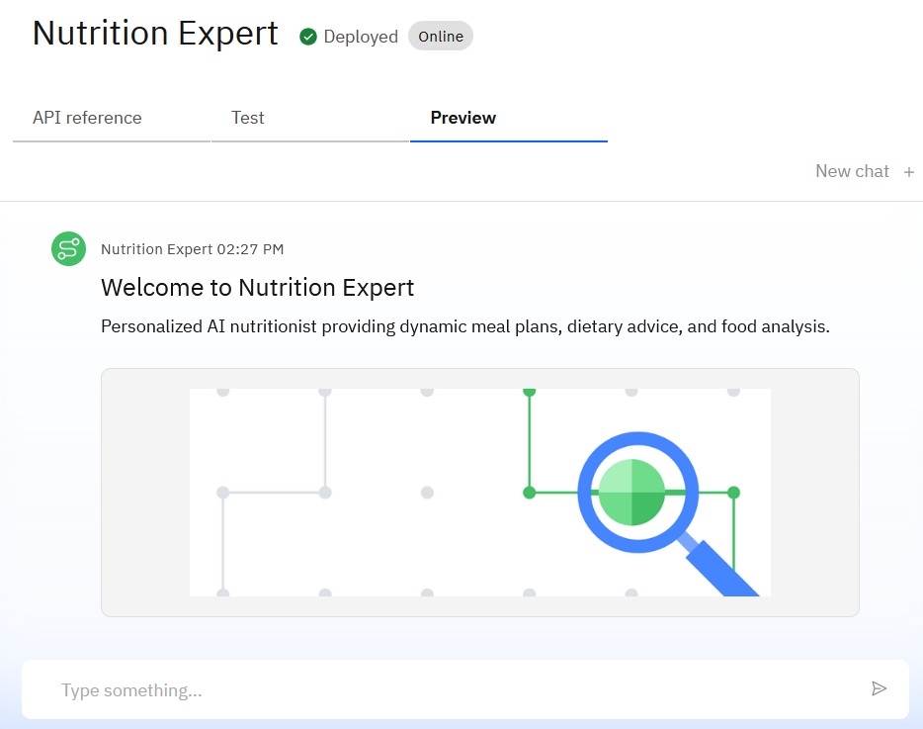
Results

Slide 9
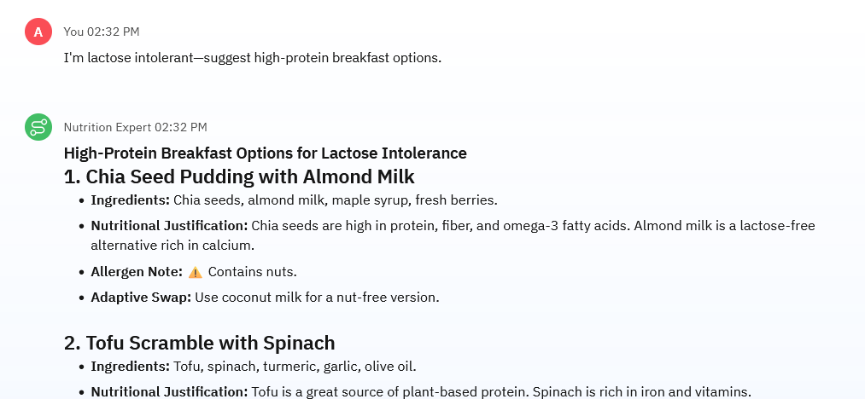
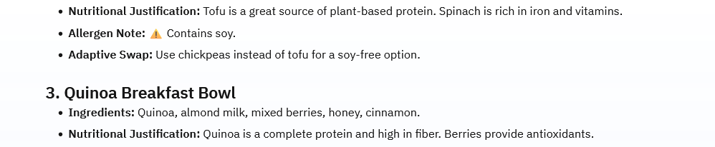
Results

Slide 10
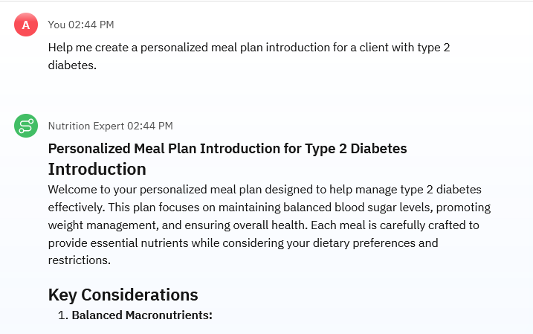
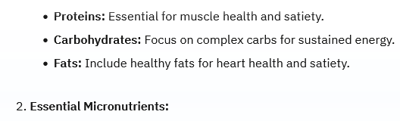
Results

Slide 11
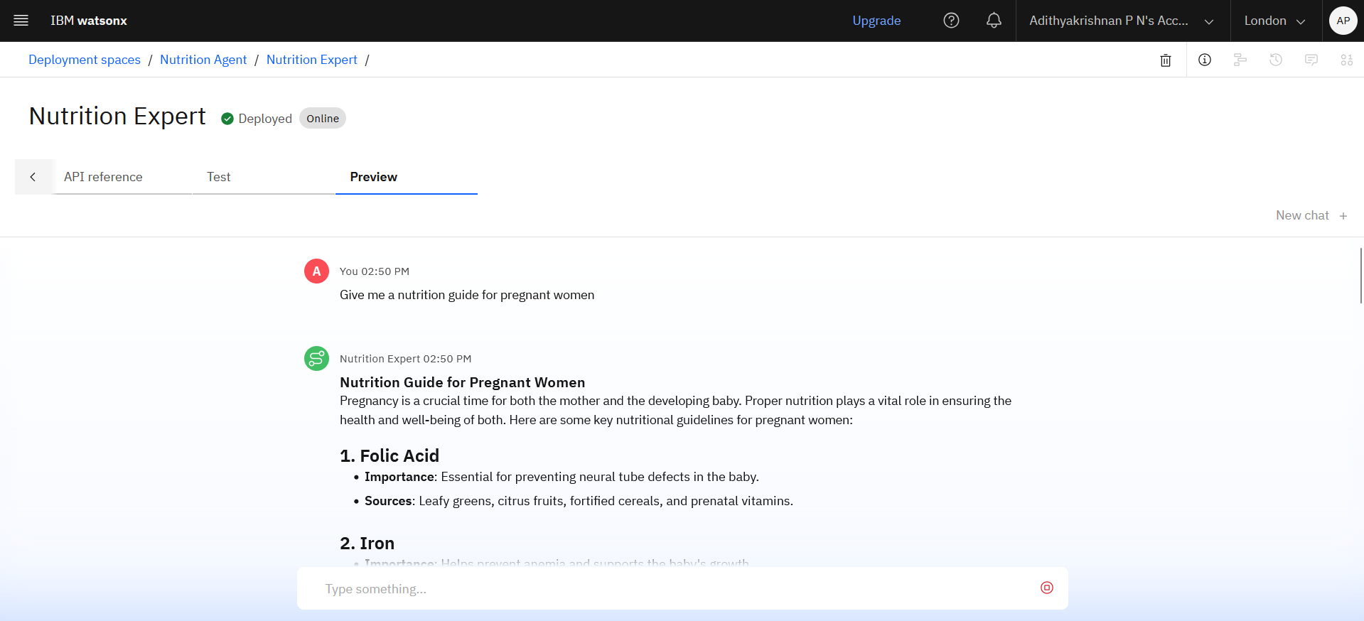
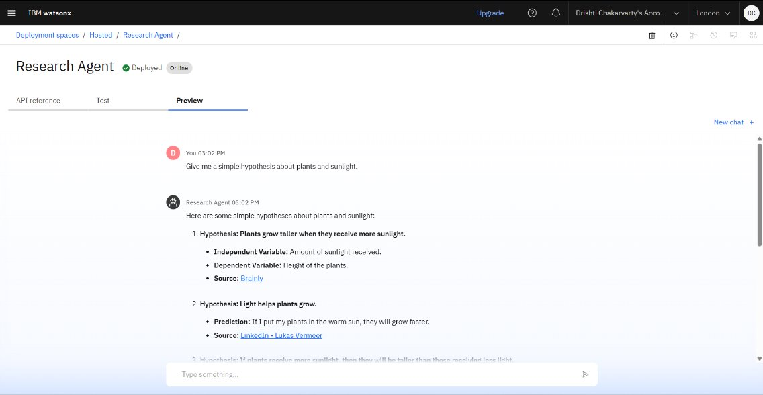
Results
Deployed AI Agent

Slide 12
Conclusion
• The Nutrition Agent generates personalized meal plans, explains nutritional choices, and adapts to user feedback in real-time. • It saves time by automating diet analysis and replacing generic meal apps with AI-powered customization.
•This AI assistant bridges the gap between one-size-fits-all diet tools and human nutritionists, delivering scalable, science-backed dietary guidance.

Slide 13
Future scope
• Multilingual Nutrition Support (Hindi, Spanish, etc. for diverse users) • Voice-Activated Meal Logging ("Add today's lunch: grilled chicken salad") • Real-Time Health Data Sync (Fitbit/Apple Health integration) • Personalized Nutrient Gap Analysis (identifies vitamin/mineral deficiencies) • Grocery Delivery API Integration (orders suggested foods automatically) • AI-Assisted Diet Journaling (auto-generates progress reports)

Slide 14
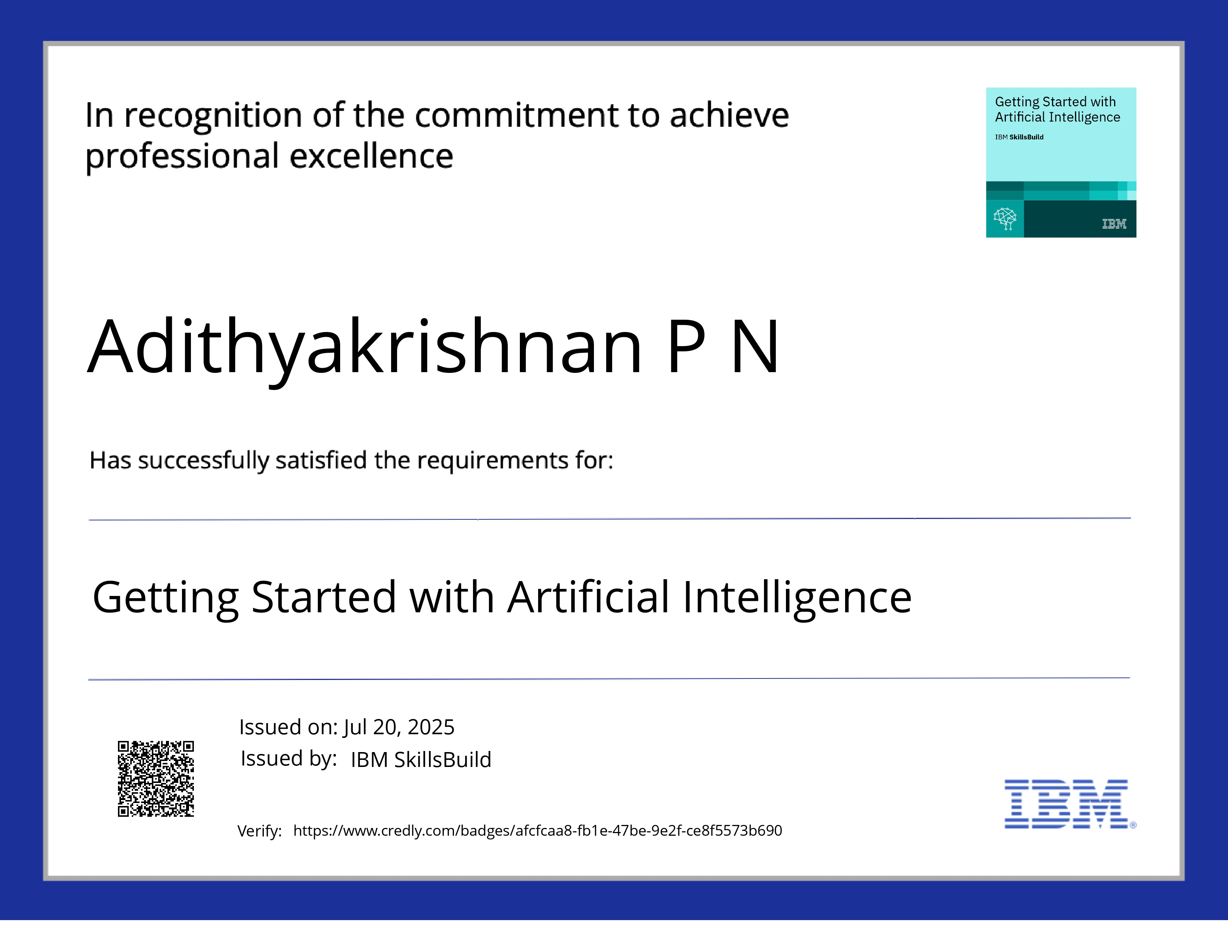
IBM Certifications

Slide 15
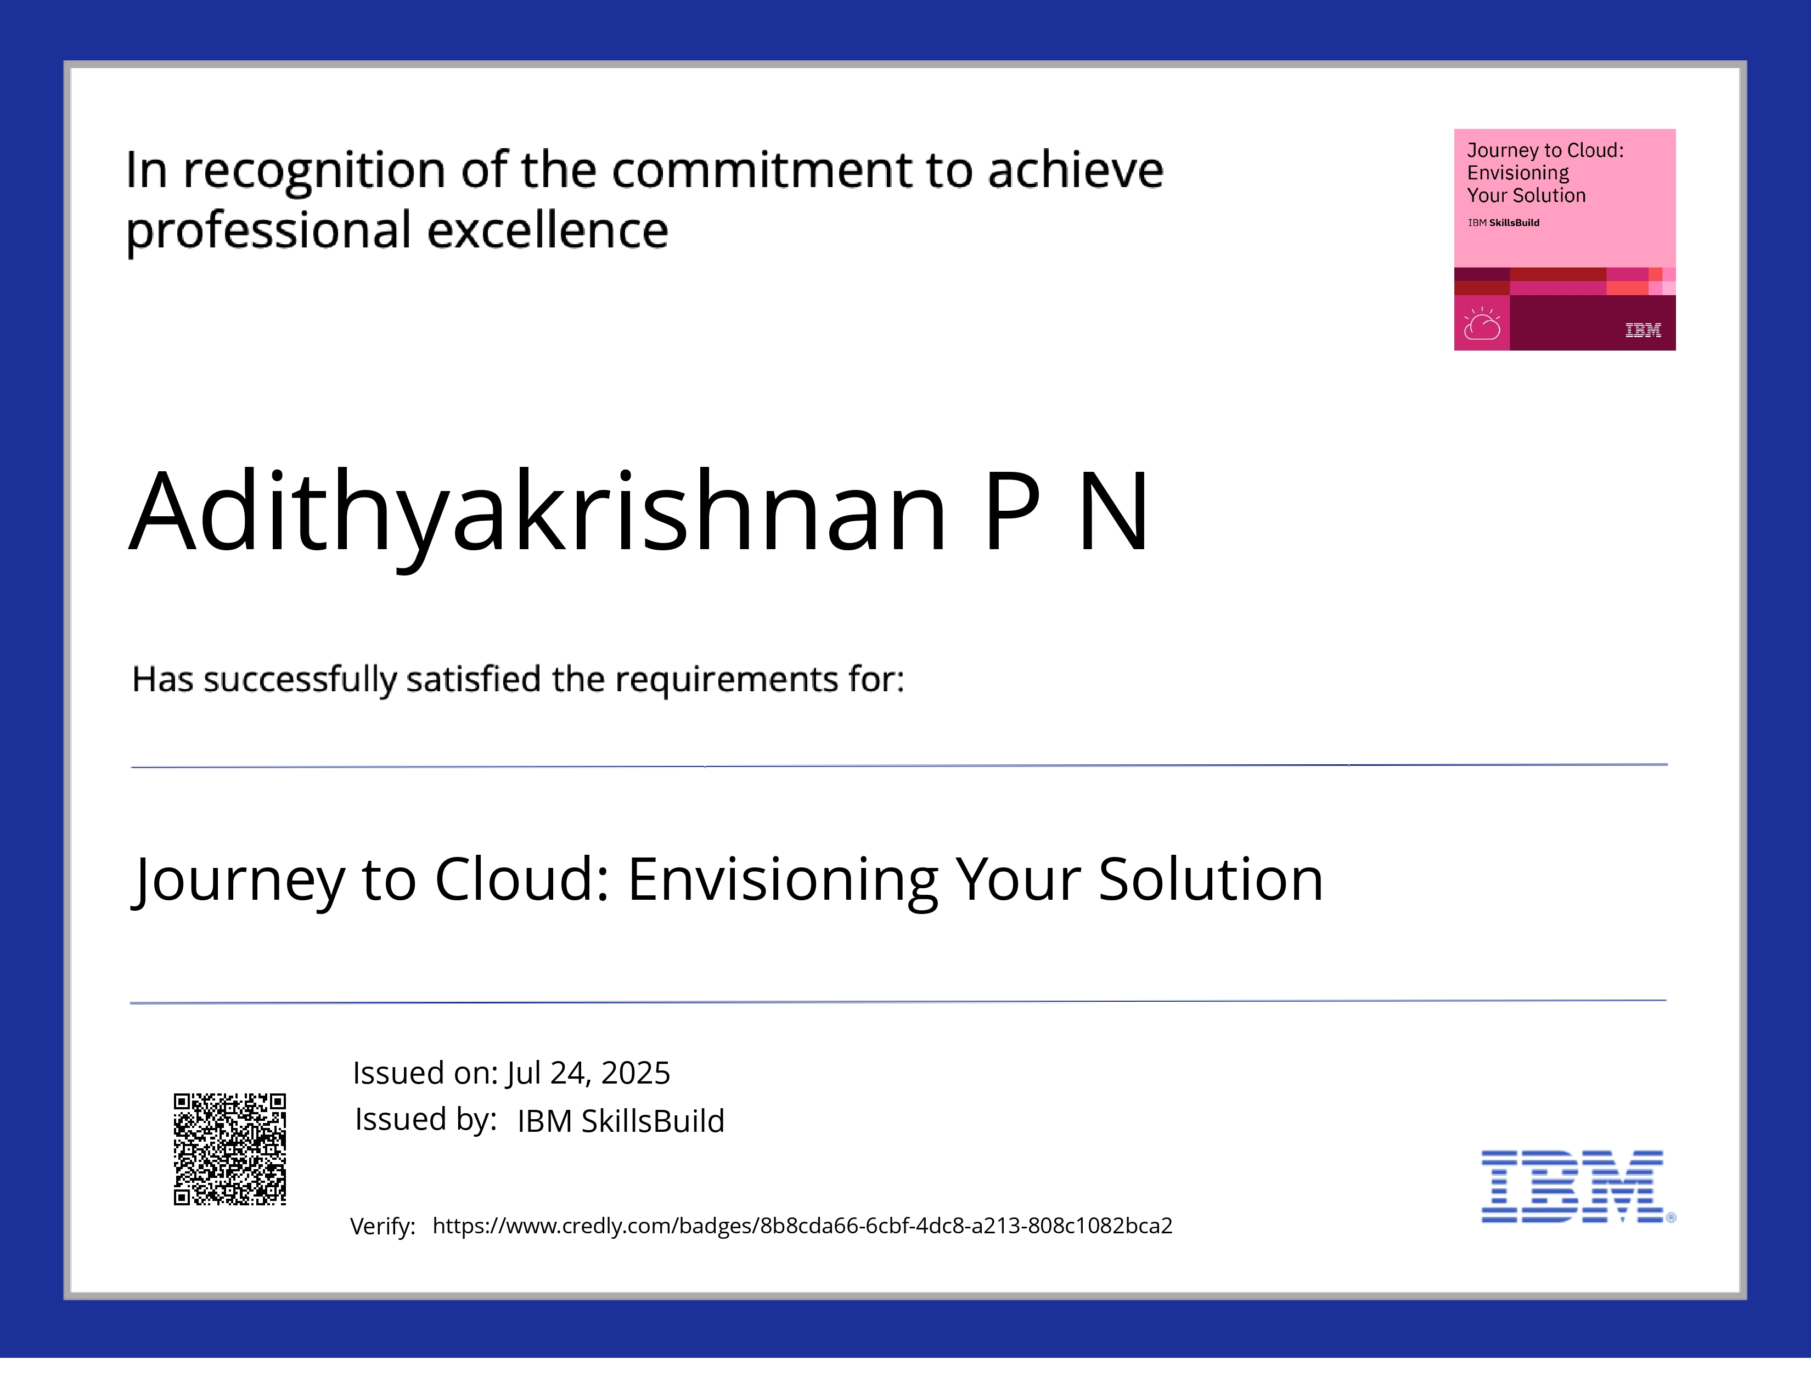
IBM Certifications

Slide 16
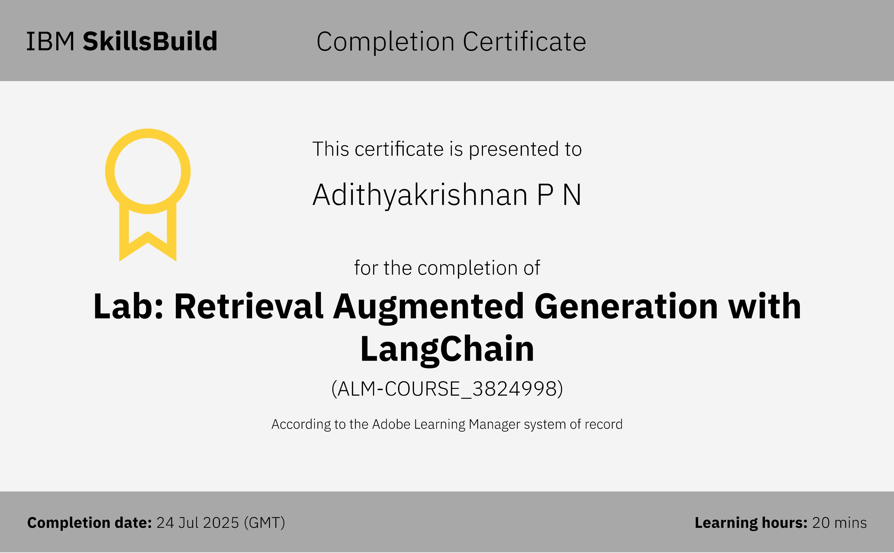
IBM Certifications

Slide 17
GitHub Link
https://github.com/adithyakrish0/AI_Nutrition_Expert

Slide 18
THANK YOU

